Slide 1
2020 ICM Problem D
Teaming Strategies
华南理工大学数学学院
刘深泉教授

Slide 2
2020 ICM Weekend 1
Problem D Teaming Strategies
As societies become more interconnected, the set of challenges they face have become increasingly complex. We rely on interdisciplinary teams of people with diverse expertise and varied perspectives to address many of the most challenging problems. Our conceptual understanding of team success has advanced significantly over the past 50+ years allowing for better scientific, creative, or physical teams to address these complex issues. Researchers have reported on best strategies for assembling teams, optimal interactions among teammates, and ideal leadership styles. Strong teams across all sectors and domains are able to perform complex tasks unattainable through either individual efforts or a sequence of additive contributions of teammates.
One of the most informative settings to explore team processes is in competitive team sports. Team sports must conform to strict rules that may include, but are not limited to, the number of players, their roles, allowable contact between players, their location and movement, points earned, and consequences of violations. Team success is much more than the sum of the abilities of individual players. Rather, it is based on many other factors that involve how well the teammates play together. Such factors may include whether the team has a diversity of skills (one person may be fast, while another is precise), how well the team balances between individual versus collective performance (star players may help leverage the skills of all their teammates), and the team’s ability to effectively coordinate over time (as one player steals the ball from an opponent, another player is poised for offense).

Slide 3
This data set was processed from a much larger dataset covering nearly 2000 matches from five European national soccer competitions, as well as the 2018 World Cup
In light of your modeling skills, the coach of the Huskies, your home soccer (known in Europe and other places as football) team, has asked your company, Intrepid Champion Modeling (ICM), to help understand the team’s dynamics. In particular, the coach has asked you to explore how the complex interactions among the players on the field impacts their success. The goal is not only to examine the interactions that lead directly to a score, but to explore team dynamics throughout the game and over the entire season, to help identify specific strategies that can improve teamwork next season. The coach has asked ICM to quantify and formalize the structural and dynamical features that have been successful (and unsuccessful) for the team.
The Huskies have provided data[1] detailing information from last season, including all 38 games they played against their 19 opponents (they played each opposing team twice). Overall, the data covers 23,429 passes between 366 players (30 Huskies players, and 336 players from opposing teams), and 59,271 game events.

Slide 4
To respond to the Huskie coach’s requests, your team from ICM should use the provided data to address the following:
Create a network for the ball passing between players, where each player is a node and each pass constitutes a link between players. Use your passing network to identify network patterns, such as dyadic and triadic configurations and team formations. Also consider other structural indicators and network properties across the games. You should explore multiple scales such as, but not limited to, micro (pairwise) to macro (all players) when looking at interactions, and time such as short (minute-to-minute) to long (entire game or entire season).
Identify performance indicators that reflect successful teamwork (in addition to points or wins) such as diversity in the types of plays, coordination among players or distribution of contributions. You also may consider other team level processes, such as adaptability, flexibility, tempo, or flow. It may be important to clarify whether strategies are universally effective or dependent on opponents’ counter-strategies. Use the performance indicators and team level processes that you have identified to create a model that captures structural, configurational, and dynamical aspects of teamwork.

Slide 5
Attachment ： 2020_Problem_D_DATA.zip fullevents.csv ， matches.csv ， passingevents.csv ， README.txt
Use the insights gained from your teamwork model to inform the coach about what kinds of structural strategies have been effective for the Huskies. Advise the coach on what changes the network analysis indicates that they should make next season to improve team success.
Your analysis of the Huskies has allowed you to consider group dynamics in a controlled setting of a team sport. Understanding the complex set of factors that make some groups perform better than others is critical for how societies develop and innovate. As our societies increasingly solve problems involving teams, can you generalize your findings to say something about how to design more effective teams? What other aspects of teamwork would need to be captured to develop generalized models of team performance?

Slide 6
Glossary
Dyadic Configurations: relationships involving pairs of players.
Triadic Configurations: relationships involving groups of three players.
Cited Reference
[1] Pappalardo, L., Cintia, P., Rossi, A. et al. A public data set of spatio-temporal match events in soccer competitions. Sci Data 6, 236 (2019).
Optional Resources
Research in football (soccer) networks has led to many articles that discuss related topics. A few articles are listed below. You are not required to use any of these sample articles in your solution, nor is it a comprehensive list. We encourage teams to utilize any journal article that supports their approach to the problem.
Buldú, J.M., Busquets, J., Echegoyen, I. et al. (2019). Defining a historic football team: Using Network Science to analyze Guardiola’s F.C. Barcelona. Sci Rep, 9, 13602.
Cintia, P., Giannotti, F., Pappalardo, L., Pedreschi, D., & Malvaldi, M. (2015). The harsh rule of the goals: Data-driven performance indicators for football teams. 2015 IEEE International Conference on Data Science and Advanced Analytics (DSAA), 1-10, 7344823.
Duch J., Waitzman J.S., Amaral L.A.N. (2010). Quantifying the performance of individual players in a team activity. PLoS ONE, 5: e10937.
GÜRSAKAL, N., YILMAZ, F., ÇOBANOĞLU, H., ÇAĞLIYOR, S. (2018). Network Motifs in Football. Turkish Journal of Sport and Exercise, 20 (3), 263-272.

Slide 7
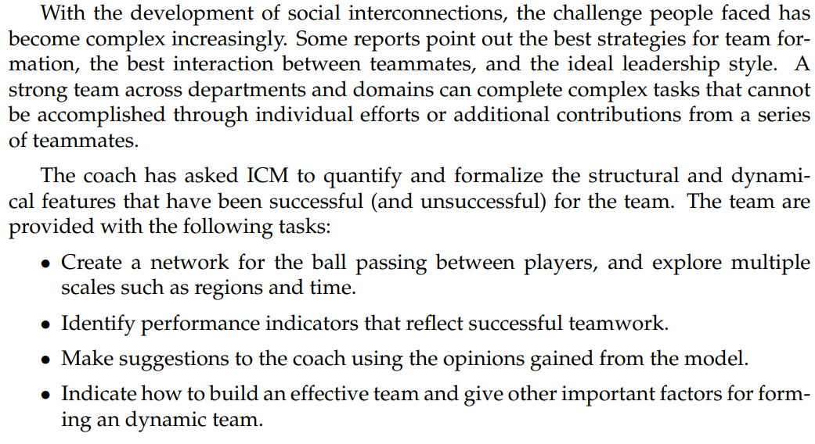
Problem Background

Slide 8
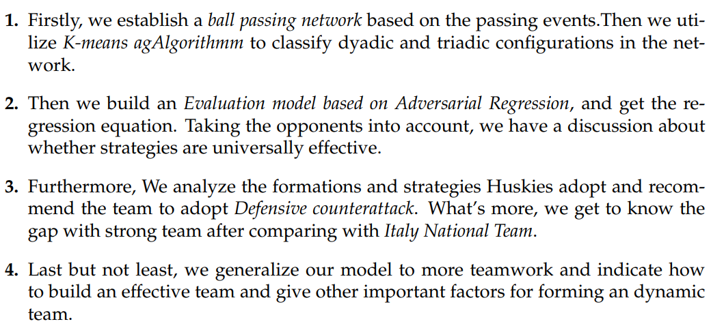
Paper work

Slide 9
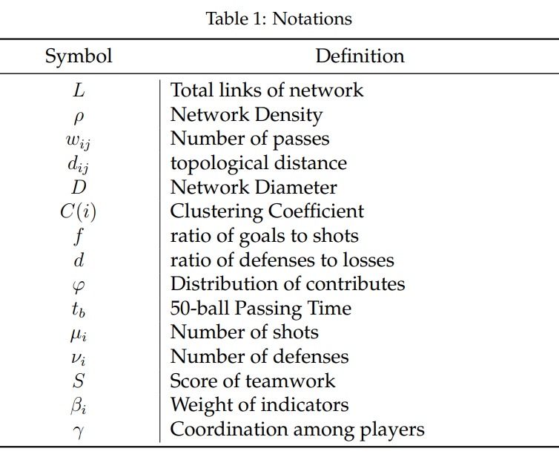
Assumptions and Justifications
• The ball passing network is an undirected graph.
• The incoming player substitutes the out going player directly, without changing the team formation.
• There is no difference between the opponents strength level, which lies in the opponents counter strategy.
• Each player,either of Huskies or of opponents,has the same physical quality and individual ability.

Slide 10
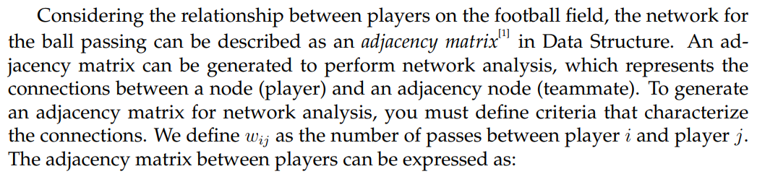
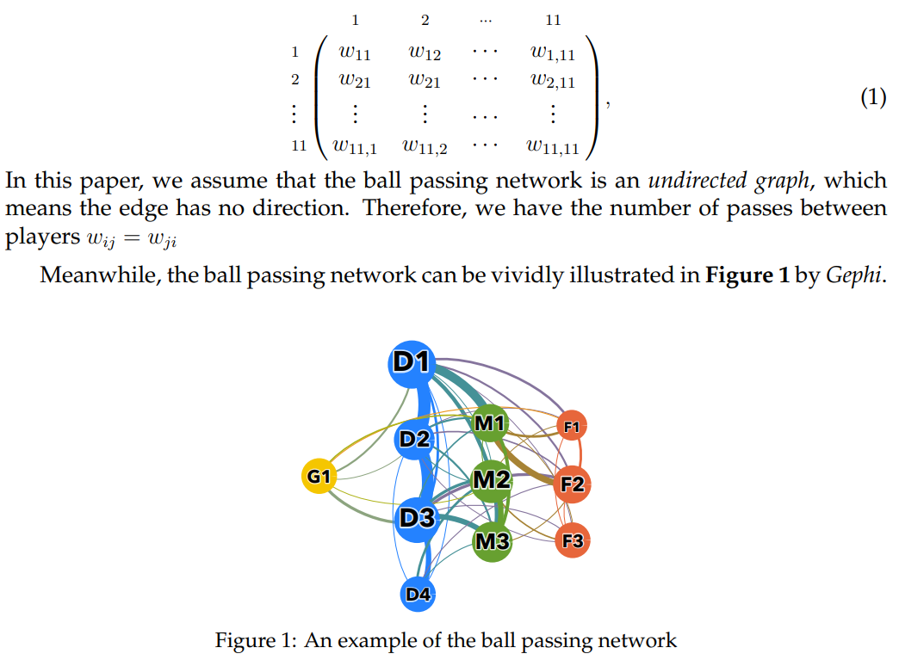
TASK1:
Ball Passing
Network Model

Slide 11
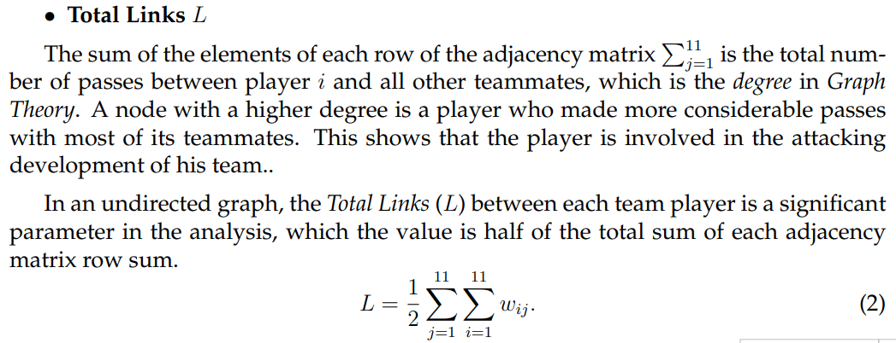
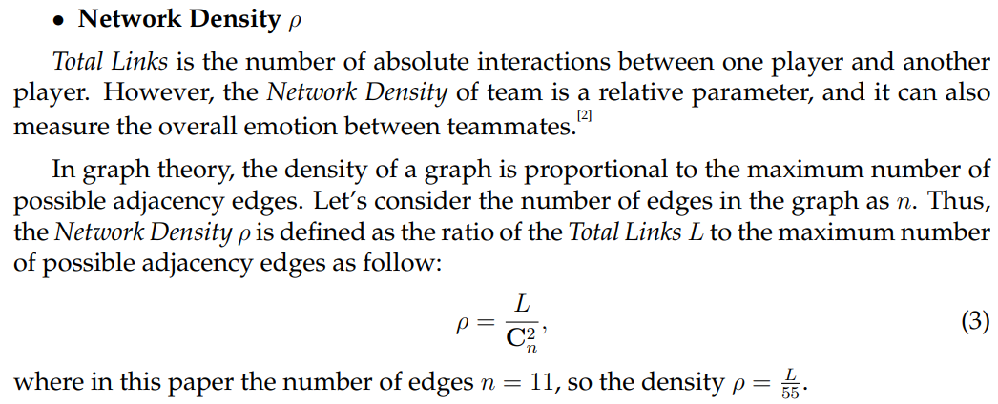
Determination of Network Parameter total links,density，diameter,clustering coefficient.

Slide 12
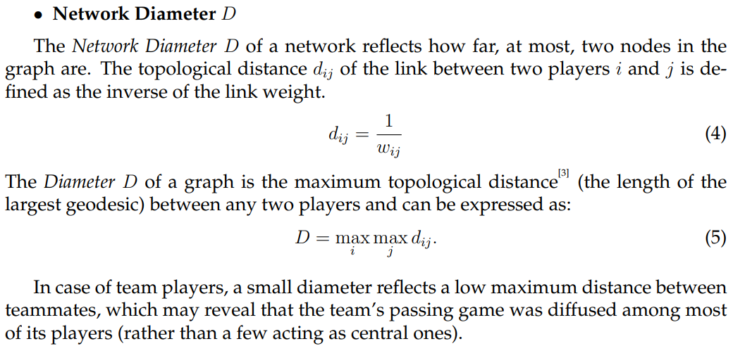
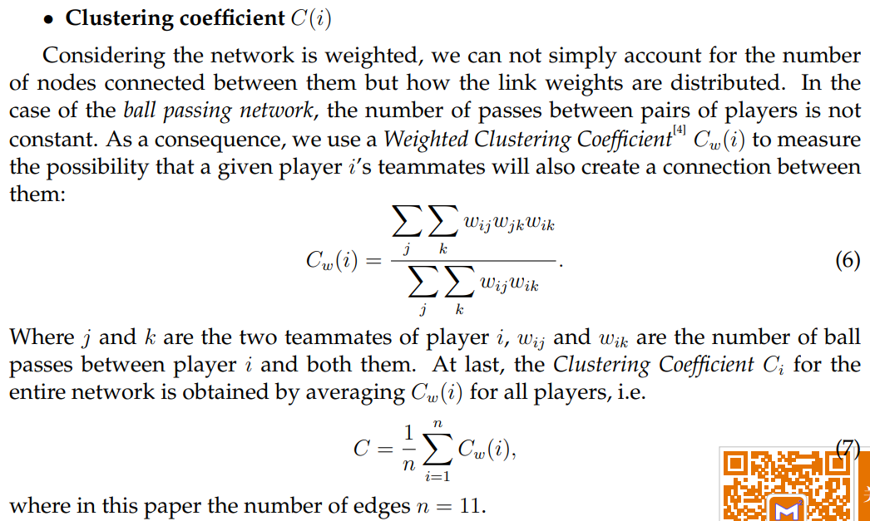

Slide 13
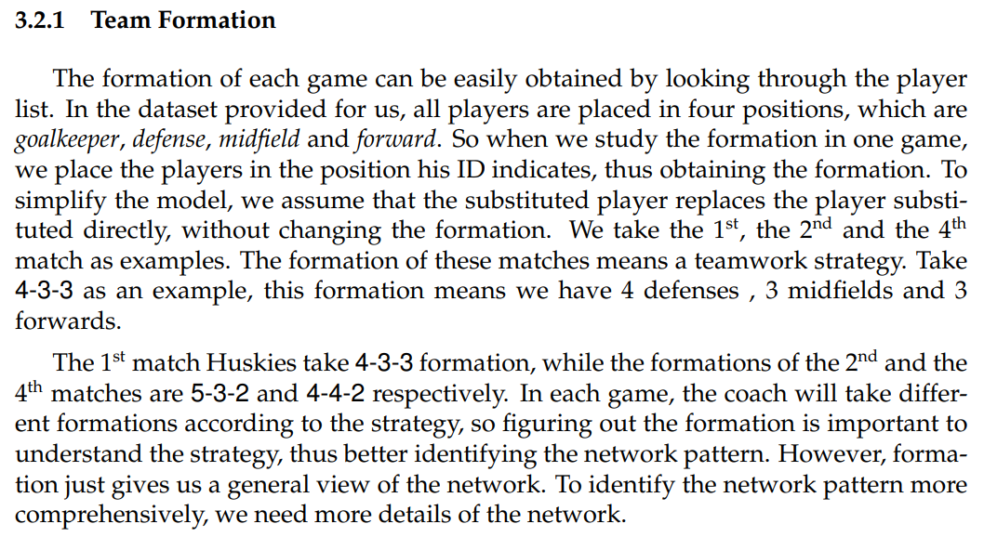
Identification of Network Patterns goalkeeper, defense, midfield and forward

Slide 14
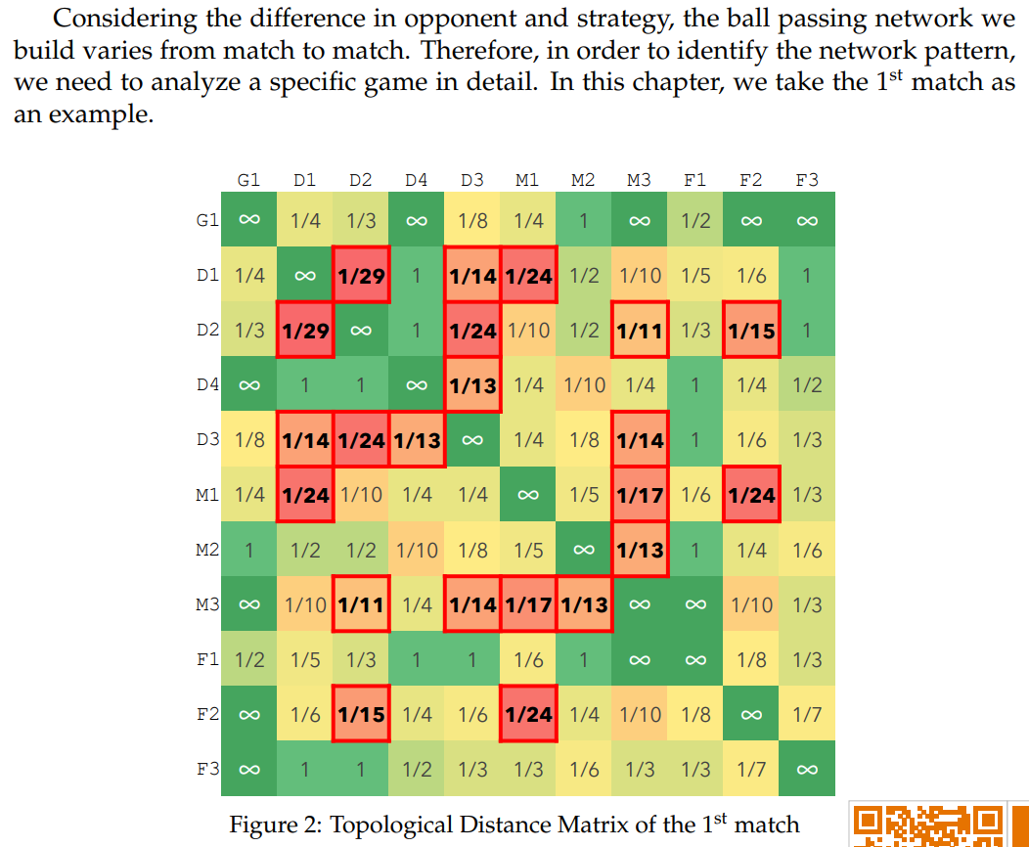
Dyadic and Triadic Configurations

Slide 15
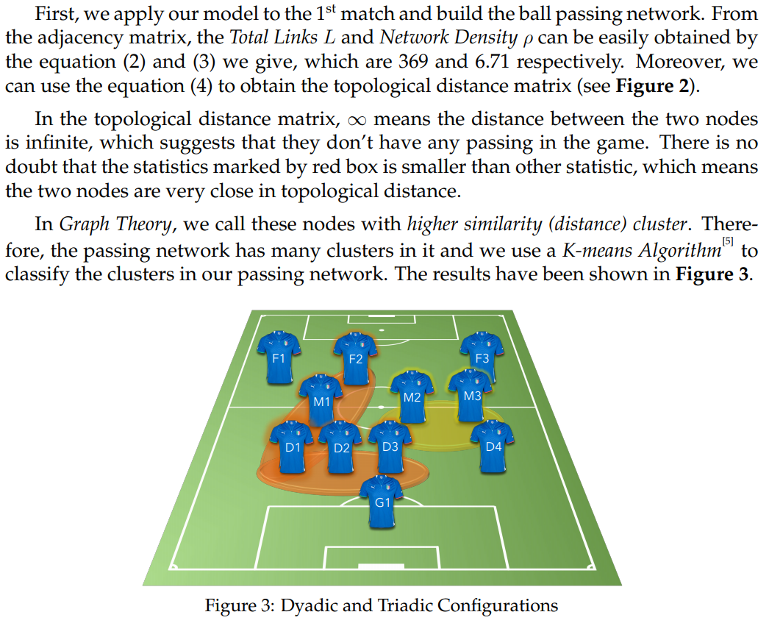

Slide 16
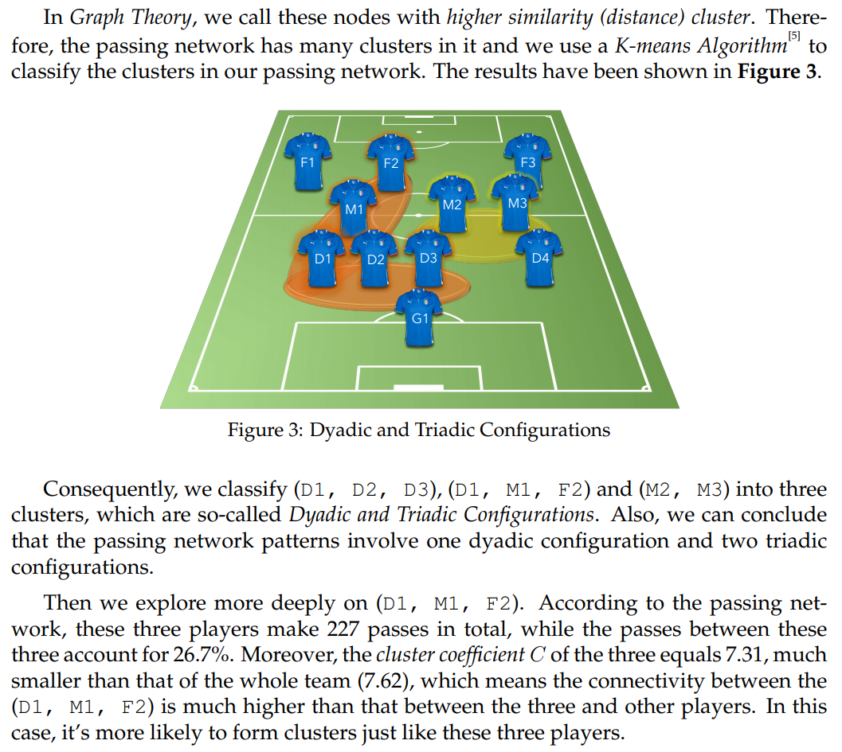

Slide 17
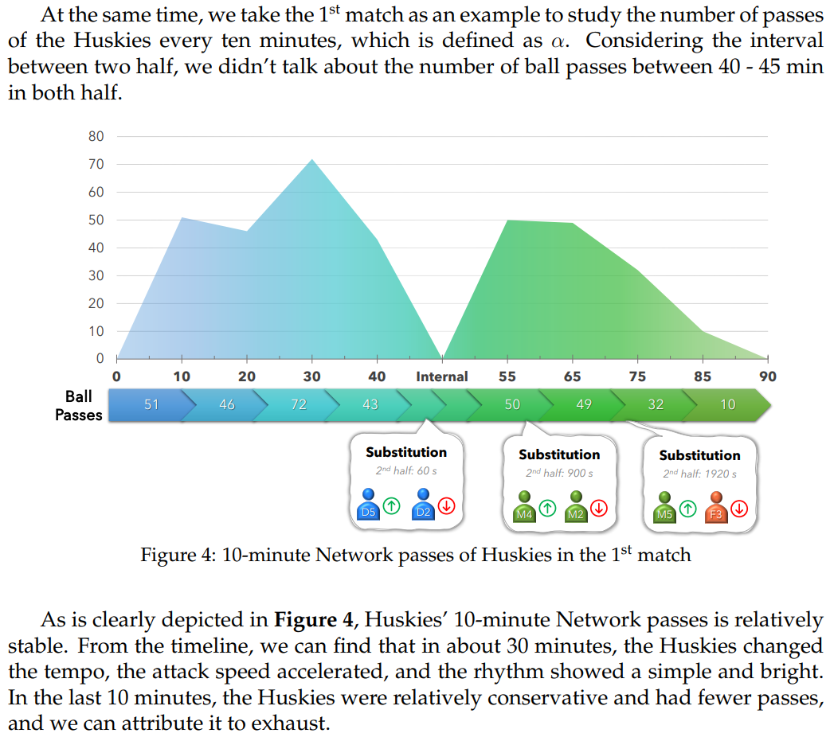
Other Structural Indicators
（1）Time Scale-10-minute network passes

Slide 18
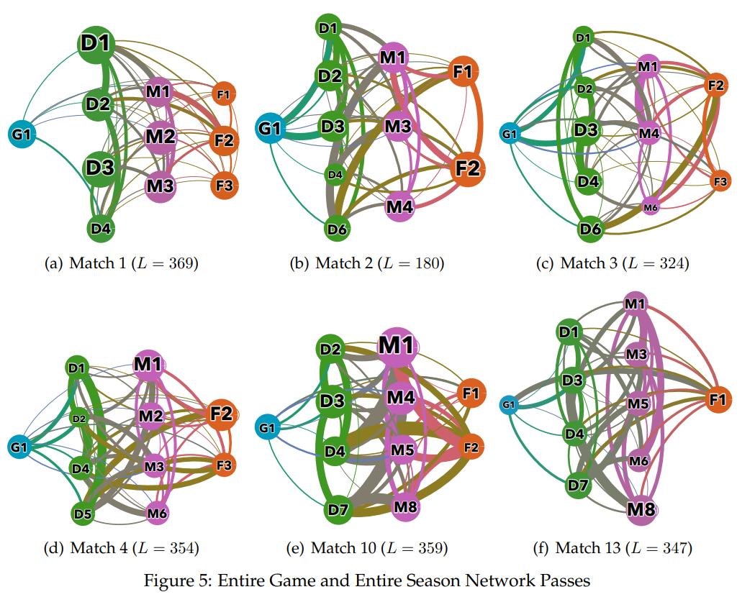
Other Structural Indicators
（2）the entire game network passes.

Slide 19
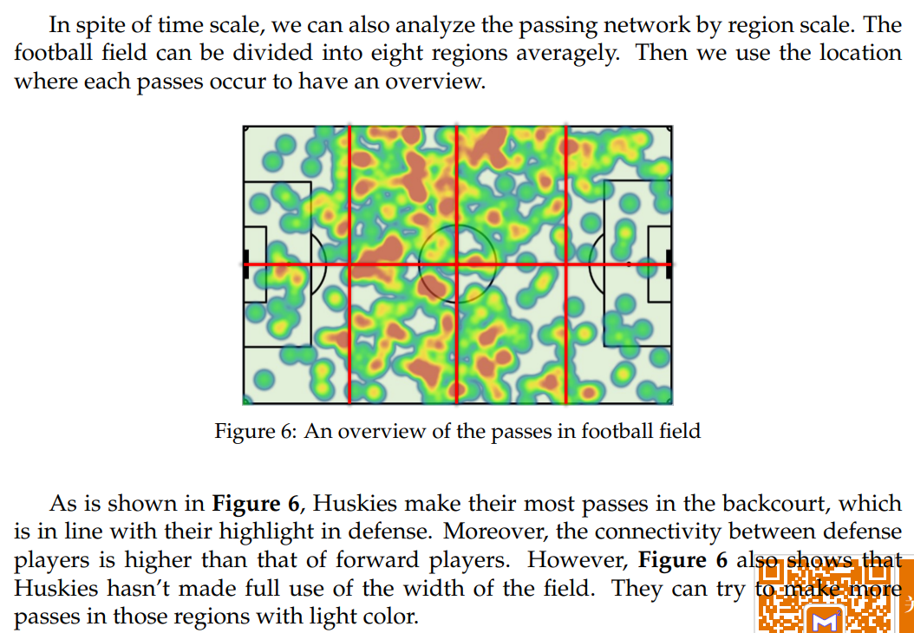
Other Structural Indicators
Region Scale

Slide 20
TASK2: Evaluation of Successful Teamwork
This paper simplifies the performance indicators into two aspects:
(1) Static: The Static performance indicators mainly contain: Coordination among players,
Distribution of contributions.
(2) Dynamic: The Dynamic performance indicators involve:
tempo,
flexibility,
Pressing.

Slide 21
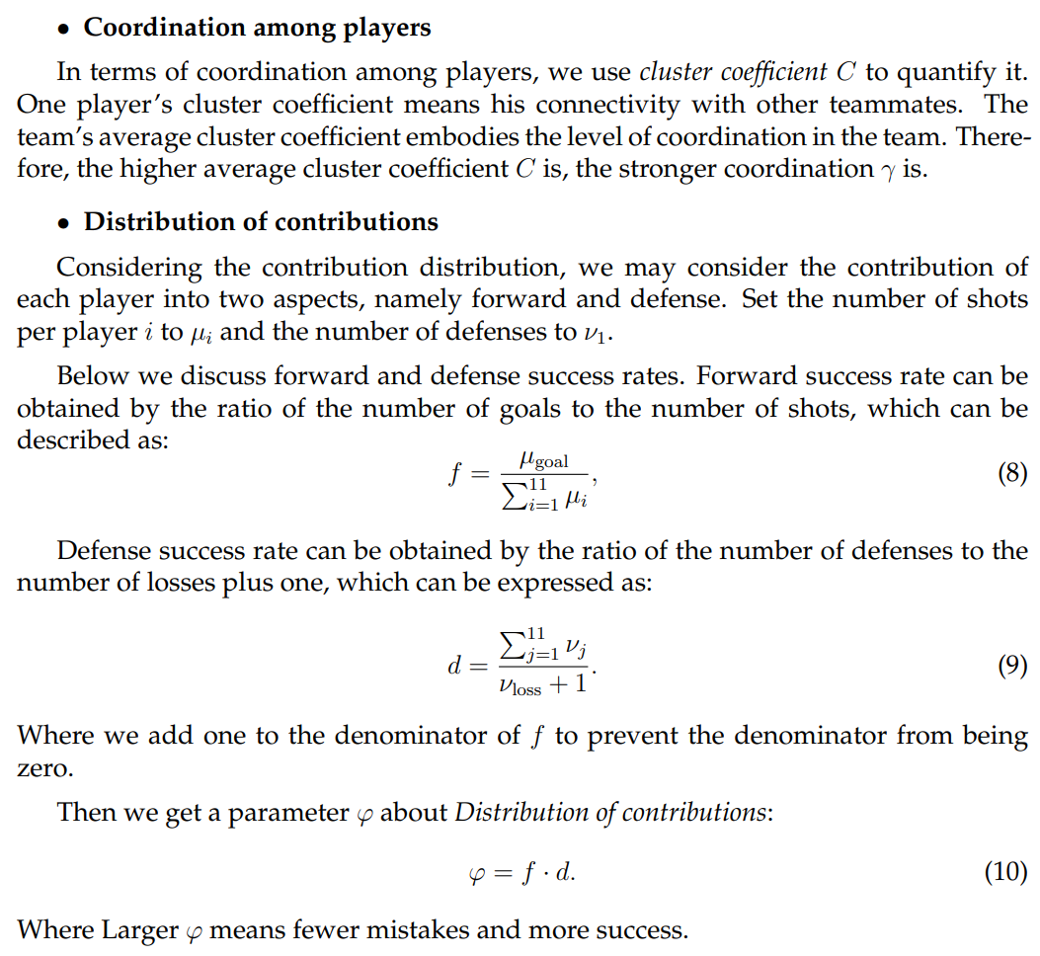

Slide 22
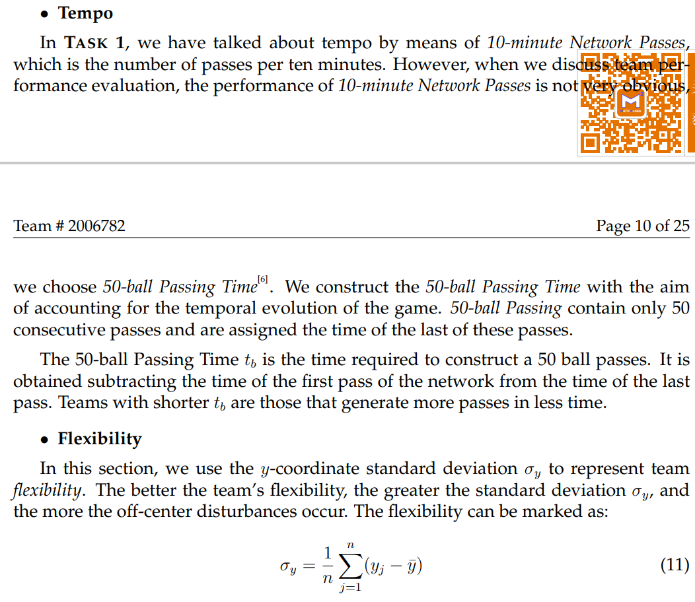
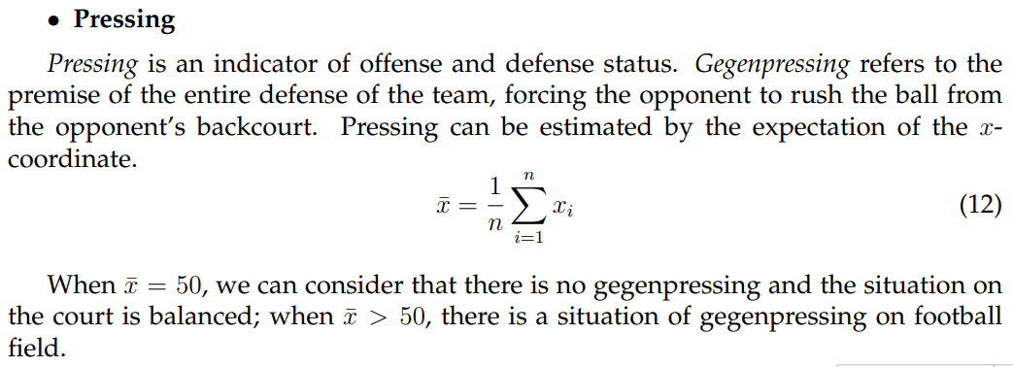

Slide 23
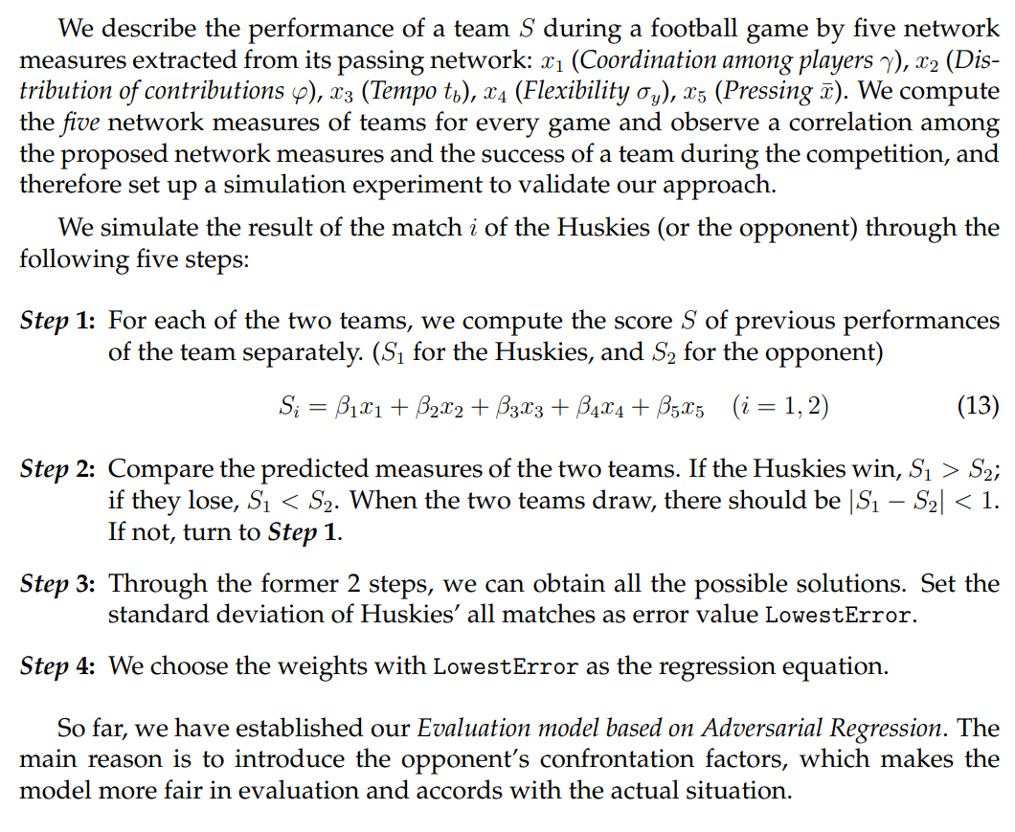
Evaluation model based on Adversarial Regression

Slide 24
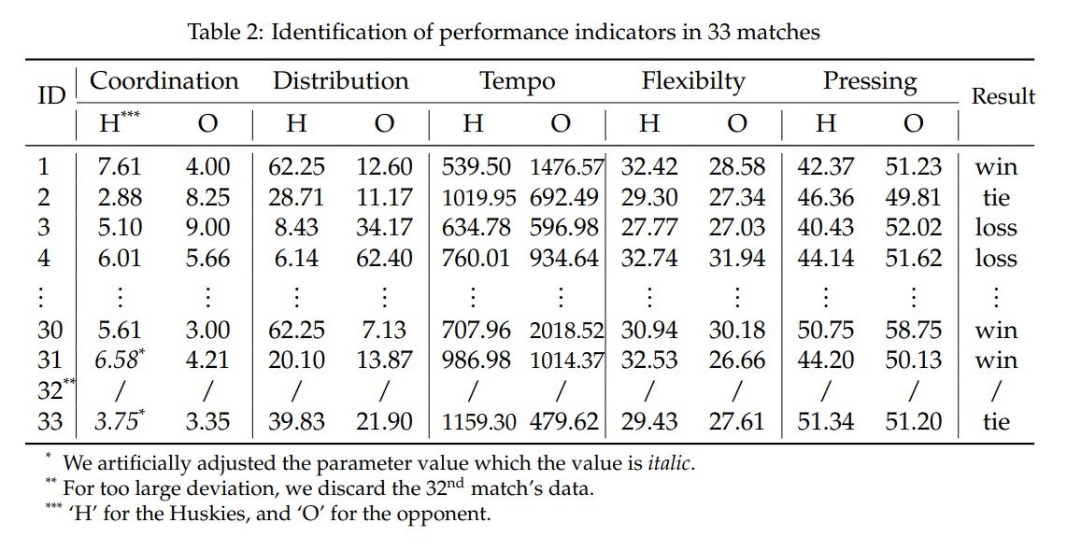
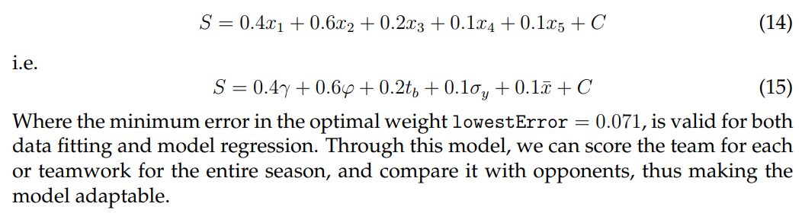
Application of Evaluation Model

Slide 25
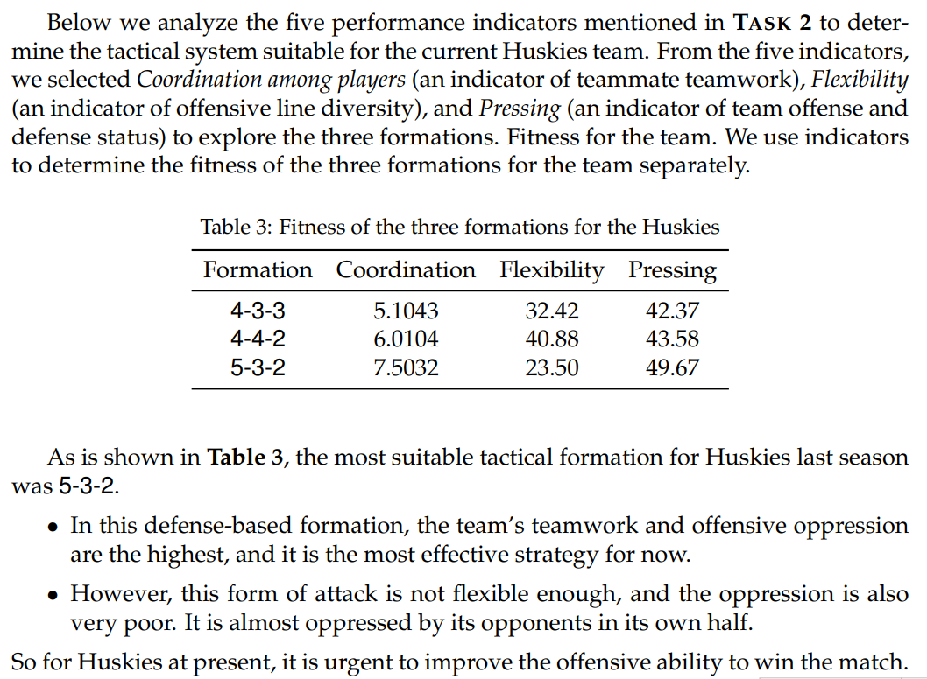
TASK3: Advice on Improving Team Success
Structural Strategy Analysis

Slide 26
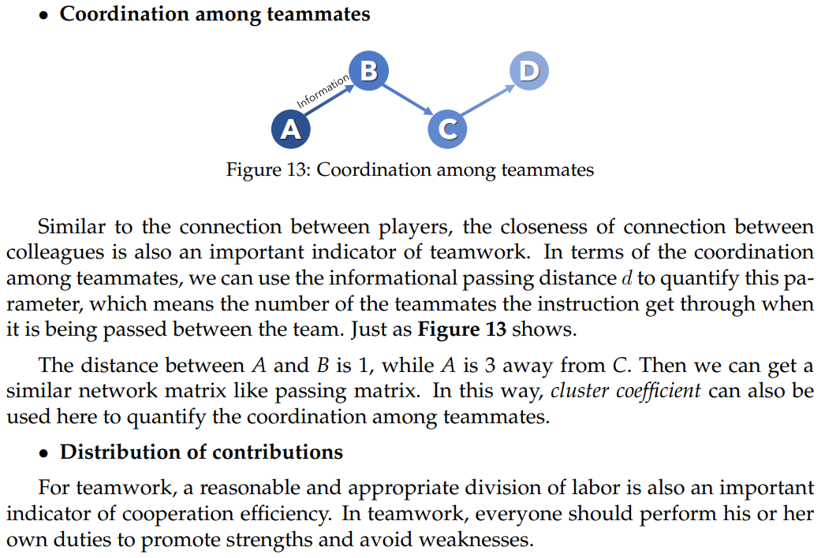
TASK4:How to Design more Effective Teams

Slide 27
Summary
The selection of the network parameters of the passing network is scientific and reasonable.The network model is highly applicable and can reflect the character istics of various aspects of the team and the evaluation scale.
•The evaluation model also introduces the opponent into the evaluation system. In order to be able to compare against the Huskies team, the weight coefficients of the five indicators are returned to be more scientific and reasonable.
•Our model analyzes the Huskies team’s data thoroughly, finds more effective strategies for the team,proposes constructive changes, and visualizes our strategies.
Thanks

